Slide 1
AYSO Region 894
Parent Guide
Spring 2022
Notes:
Welcome to the Parent’s Guide to AYSO Region 894 Spring 2017

Slide 2
Purpose
More info about AYSO & Region 894
How to Register
Info about the Spring 2022 Season, how to participate and get the most out of the season

Slide 3
AYSO Region 894
The American Youth Soccer Organization
Region 894 serves the Monrovia, Harvest and Toney areas – started in 1993

Slide 4
Our Vision
To provide world class youth soccer programs that
enrich children’s lives.

Slide 5
Our Mission
To develop and deliver quality youth soccer programs which promote a fun, family environment based on AYSO's Six Philosophies.
Everyone Plays
Balanced Teams
Open Registration
Positive Coaching
Good Sportsmanship
Player Development

Slide 6
Everyone Plays®
Our program’s goal is for kids to play soccer so we mandate that every player on every team must play at least 50 percent of every game. It’s no fun to spend the game on the bench…and that’s no way to learn soccer!

Slide 7
Balanced Teams
Each year we form new teams as evenly balanced as possible because it’s more fun and a better learning experience when teams of similar ability play. It allows for each player to gain the experience of a wide variety of teammates of different skill levels.

Slide 8
Open Registration
Our program is open to all children between 4 and 19 years of age who want to register and play soccer. Interest and enthusiasm are the only criteria for playing. There are no elimination try-outs and nobody gets cut.

Slide 9
Positive Coaching
Encouragement of player effort provides for greater enjoyment for the players and leads to better-skilled and better-motivated players. A coach can be one of the most influential people in a child’s life, so AYSO requires they create a positive experience for every boy and girl.

Slide 10
Good Sportsmanship
We strive to create a positive environment based on mutual respect rather than a win-at-all-costs attitude, and our program is designed to instill good sportsmanship in every facet of AYSO.

Slide 11
Player Development
We believe that all players should be able to develop their soccer skills and knowledge to the best of their abilities, both individually and as members of a team, in order to maximize their enjoyment of the game.

Slide 12
How To Register
https://www.ayso894.net
$40 if played in the Fall season
$60 for New Players

Slide 13
Volunteers Needed!
AYSO 894 is 100% volunteer powered
Coaches, referees, division coordinators, registrars, treasurers, field managers and commissioners are all volunteers
Volunteers strengthen AYSO by giving their time and energy, their ideas and ideals. Volunteers make AYSO happen.

Slide 14
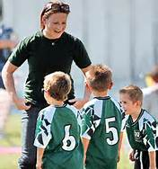
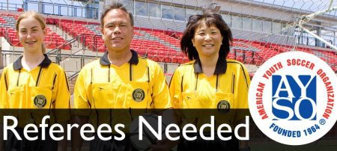
Please Volunteer!
Coaches Needed!

Slide 16
Divisions
5U: 4 year-olds
6U: 5 year-olds
8U: 6-7 year-olds
10U: 8-9 year-olds
12U: 10-11 year-olds
14U: 12-13 year-olds
16U: 14-15 year-olds
19U: 16-18 year-olds
Based on age as of December 31st, 2022

Slide 17
Equipment: What Players Need
Required: Shinguards, completely covered by long socks, are mandatory during practice and games. Shoes are required, and it is advisable to use shoes designed specifically for soccer (NOT football or baseball/softball cleats!).
Recommended: soccer ball and water.

Slide 18
Equipment
No watches, wristbands, hair beads, earrings or other jewelry allowed during practices or games
Soft braces (meant to protect) are OK.
Casts or splints (meant to immobilize) are not allowed (and cannot simply be removed)

Slide 19
Ball Sizes
5U-8U: Size 3
10U-12U: Size 4
14U-19U: Size 5

Slide 20
Fields
5-6U, 8U: Endeavor Elementary School/Madision Crossroads CC (Toney)
10U: Asbury Church Harvest, Wall Triana Hwy
12U: Harvest Baptist Church, Ford Chapel Rd
14U: Calvary Baptist Church, Douglas Rd
16-19U: Madison Crossroads CC

Slide 21
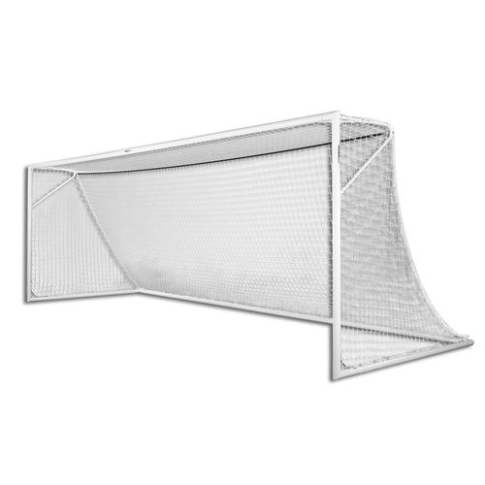
Field Safety
No pets are allowed at or near the fields
Never allow children to play on goals
Goals must be anchored at all times
Please notify us of any unsafe field conditions
Lightning & Thunder: “If you can see it - flee it; if you can hear it – fear it.”

Slide 22
No Referee, Game Canceled Policy (8U and Higher)
If a game does not have at least one referee by the deadline, the game will be canceled
For games starting before noon, the deadline is 10pm the night before
For games noon and after, the deadline is four hours before the start of the game

Slide 23
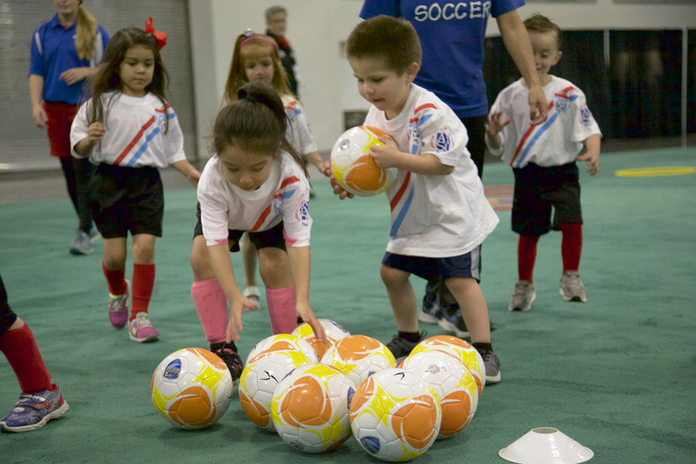
5U
Practice & Game every Saturday Morning
Start date: April 2nd
Time: 8:00am
Start with Jamboree
May form teams

Slide 24
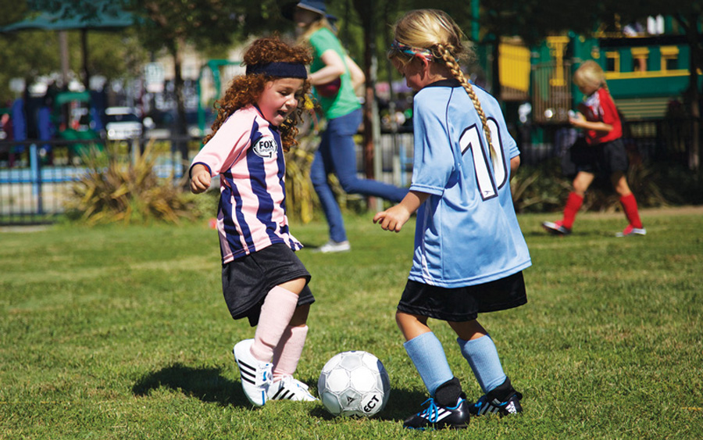
6U
Practice & Game every Saturday Morning
Start date: April 2nd
Time: 9:15am
Start with Jamboree
May form teams

Slide 25
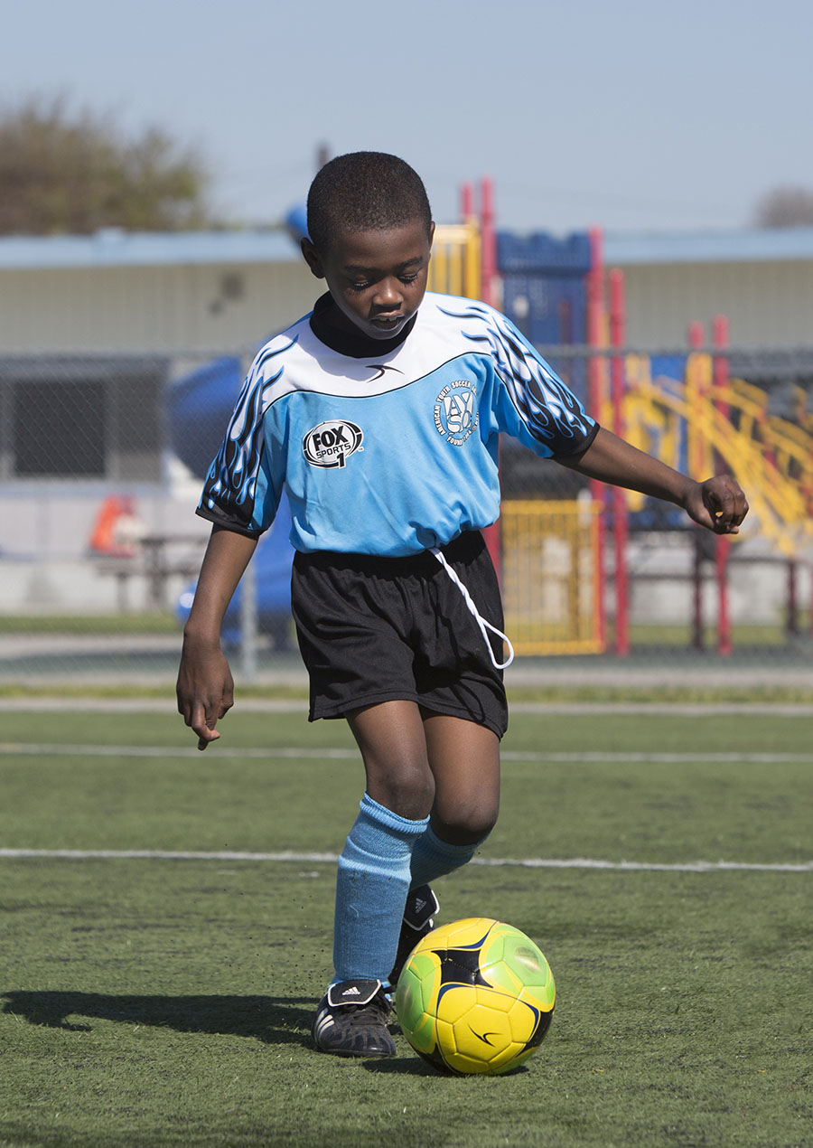
8U-12U
Practices: Two times per week, Mon, Tue, Thu or Fri, 5:00 or 6:15pm (coaches get to choose practices days and times)
Games: Typically Saturday
Practices Begin: Week of Mar 21st
Games Begin: April 2nd

Slide 26
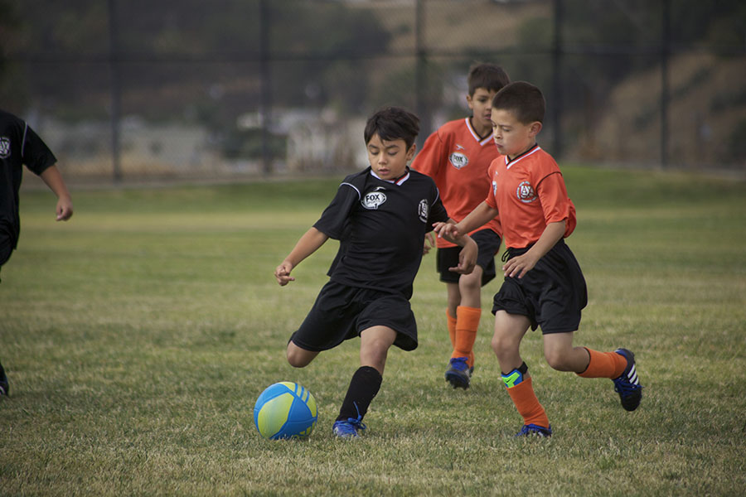
14U
Practices: Two times per week, Mon, Tue, Thu or Fri, 5:00 or 6:15pm (coaches get to choose practices days and times)
Games: Typically Saturday
Practices Begin: Week of Mar 21st
Games Begin: April 2nd

Slide 27
16-19U* (if teams can form)
Practices: Two times per week, Mon, Tue, Thu or Fri, 5:00 or 6:15pm (coaches get to choose practices days and times)
Games: Typically Saturday
Practices Begin: March 21st
Games Begin: Up to coach & available players

Slide 28
Other Dates
Last Game of the Season: May 21st
Silent Saturday (8U and up): May 7th

Slide 29
Get Announcements
Facebook: http://facebook.com/ayso894
You should receive emails from SportsConnect after you are registered

Slide 30
Get Field Updates
Facebook: http://facebook.com/ayso894
To opt-in to field announcement text messages, please text 894SPRING2022 to 84483.

Slide 31
Find Coach/Team Info
8U-12U coaches should get team assignments on or about March 20th
Log into http://www.AYSO894.net to see team affiliations

Slide 32
Questions? Need Help?
Contact coach if possible
Coach Admin: coach@ayso894.net
Ref Admin: ref@ayso894.net
Field Admin: fields@ayso894.net
Equipment: equipment@ayso894.net
Regional Commissioner: rc@ayso894.net
Voicemail: 256-322-4426

